Slide 1
Introduction to Verilog HDL
Verilog was originally intended for simulation and verification of digital circuits. Subsequently, using CAD (Computer Aided Design) tools, the Verilog Codes are synthesized into hardware implementation of the described circuit. We are using the Verilog in the lab for simulation and verification of digital circuits

Slide 2
There are two ways of describing the circuit in Verilog.
Using Verilog constructs, describe the structure of the circuit in terms of circuit elements, such as logic gates. A larger circuit is defined by writing code that connects such elements together. This approach is referred to as the structural representation of logic circuits.
Using logic expressions and Verilog programming constructs that define the desired behavior of the circuit, but not its actual structure in terms of gates, describe a circuit more abstractly. This is called the behavioral representation.

Slide 3
Structural Specification of Logic Circuits
Verilog includes a set of gate-level primitives that correspond to commonly-used logic gates.
A gate is represented by indicating its functional name, output, and inputs.
For example, a two-input AND gate, with output y and inputs x1 and x2, is denoted as
and (y, x1, x2);
A four-input OR gate is specified as
or (y, x1, x2, x3, x4);

Slide 4
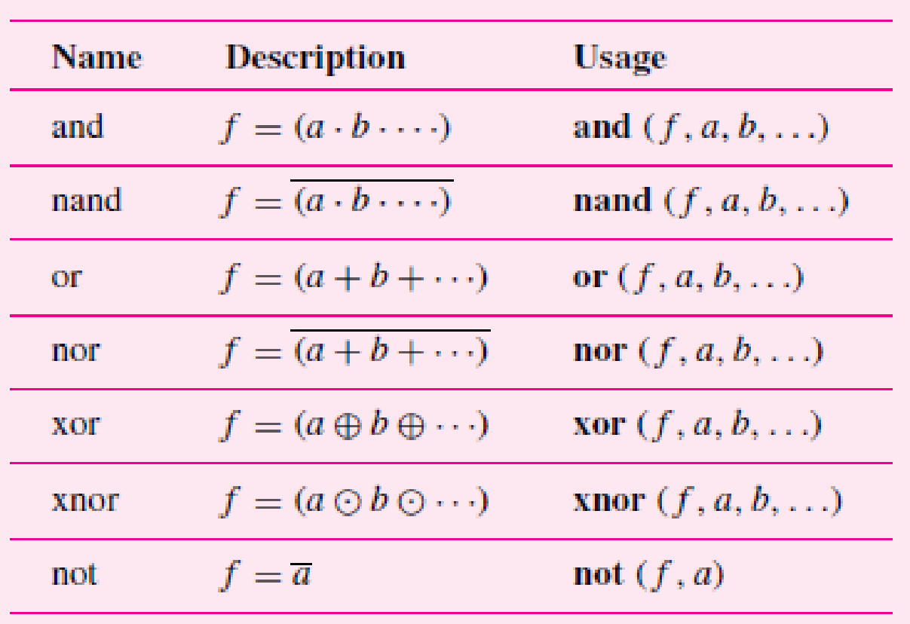
The available Verilog gate-level primitives are

Slide 5
A logic circuit is specified in the form of a module that contains the statements that define the circuit. A module has inputs and outputs, which are referred to as its ports. The word port is a commonly-used term that refers to an input or output connection to an electronic circuit.

Slide 6
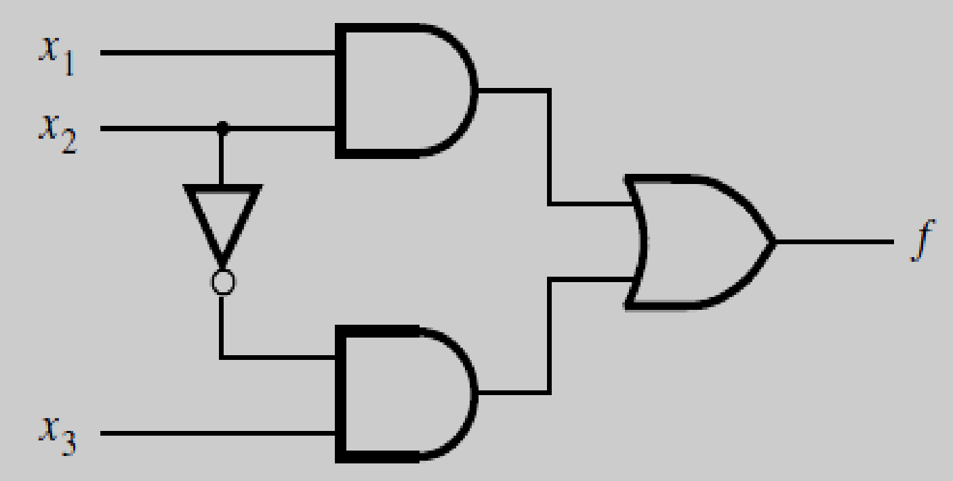
module example1(x1,x2,x3,f); input x1,x2,x3; output f; and (g,x1,x2); not (k,x2); and (h,k,x3); or (f,g,h); endmodule

Slide 7
The first statement gives the module a name, example1, and indicates that there are four port
signals. The next two statements declare that x1, x2, and x3 are to be treated as input signals, while f is the output. The actual structure of the circuit is specified in the four statements that follow. The NOT gate gives k = x2’. The AND gates produce g = x1x2 and h = kx3. The outputs of AND gates are combined in the OR gate to form f = g + h = x1x2 + kx3 = x1x2 + x2’x3. The module ends with the endmodule statement.

Slide 8
Example2:
It defines a circuit that has four input signals, x1, x2, x3, and x4, and three output signals, f, g, and h. It implements the
logic functions
g = x1x3 + x2x4
h = (x1 + x3’)(x2’ + x4)
f = g + h

Slide 9
module example2 (x1, x2, x3, x4, f, g, h);
input x1, x2, x3, x4;
output f, g, h;
and (z1, x1, x3);
and (z2, x2, x4);
or (g, z1, z2);
or (z3, x1, ~x3);
or (z4, ~x2, x4)
and (h, z3, z4);
or (f, g, h);
endmodule
Instead of using explicit NOT gates to define x2 and x3, we have used the Verilog operator “∼” (tilde character on the keyboard) to denote complementation. Thus, x2 is indicated as ∼x2 in the code.

Slide 10
Verilog Syntax
The names of modules and signals in Verilog code follow two simple rules:
The name must start with a letter, and it can contain any letter or number plus the “_” underscore and “$” characters.
Verilog is case sensitive
Indentation and blank lines can be used to make separate parts of the code easily recognizable.
Comments may be included in the code to improve its readability.
A comment begins with the double slash “//” and continues to the end of the line.

Slide 11
Behavioral Specification of Logic Circuits
Using gate-level primitives can be tedious when large circuits have to be designed. An alternative is to use more abstract expressions and programming constructs to describe the behavior of a logic circuit. One possibility is to define the circuit using logic expressions.
Behavioral specification of a logic circuit defines only its behavior. CAD synthesis tools use this specification to construct the actual circuit. The detailed structure of the
synthesized circuit will depend on the technology used.

Slide 12
module example1(x1,x2,x3,f); input x1,x2,x3; output f; assign f=(x1 & x2)| (~x2 & x3); endmodule

Slide 13
The AND and OR operations are indicated by the “&” and “|” Verilog operators, respectively. The assign keyword provides a continuous assignment for the signal f.
Behavioral code for example 2 is as follows:
module example2 (x1, x2, x3, x4, f, g, h);
input x1, x2, x3, x4;
output f, g, h;
assign g = (x1 & x3) | (x2 & x4);
assign h = (x1 | x3) & ( x2 | x4);
assign f = g | h;
endmodule

Slide 14
Operator type | Operator Symbols | Operation Performed | Number of operands
Bitwise | ~ & | ^ ~^ or ^~ | 1’s complement Bitwise AND Bitwise OR Bitwise XOR Bitwise XNOR | 1 2 2 2 2
Logical | ! && || | NOT AND OR | 1 2 2
Reduction | & ~& | ~| ^ ~^ or ^~ | Reduction AND Reduction NAND Reduction OR Reduction NOR Reduction XOR Reduction XNOR | 1 1 1 1 1 1
Arithmetic | + - - * / | Addition Subtraction 2’s complement Multiplication Division | 2 2 1 2 2
Relational | > < >= <= | Greater than Lesser than Greater than or equal to Lesser than or equal to | 2 2 2 2
Equality | == != | Logical equality Logical inequality | 2 2
Shift | >> << | Right shift Left shift | 2 2
Concatenation | {,} | Concatenation | Any number
Replication | {{}} | Replication | Any number
Conditional | ?: | Conditional | 3

Slide 15
Hierarchical Verilog Code
For larger designs, it is often convenient to create a hierarchical structure in the Verilog code, in which there is a top-level module that includes multiple instances of lower-level modules.

Slide 16
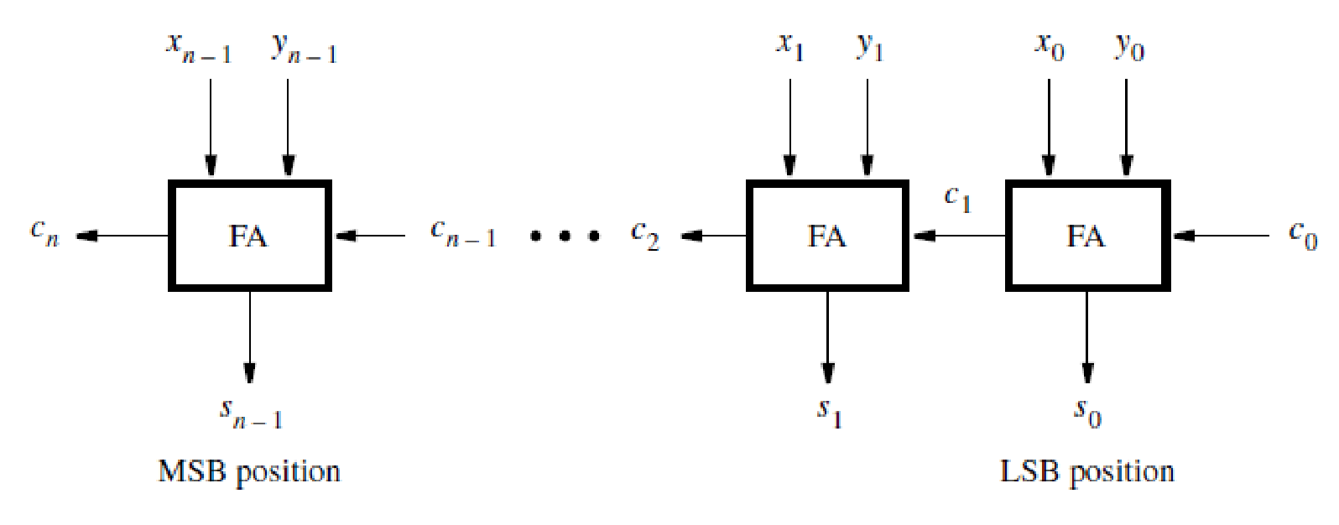
Let n=4

Slide 17
module adder4 (carryin, x3, x2, x1, x0, y3, y2, y1, y0, s3, s2, s1, s0, carryout); input carryin, x3, x2, x1, x0, y3, y2, y1, y0; output s3, s2, s1, s0, carryout; fulladd stage0 (carryin, x0, y0, s0, c1); fulladd stage1 (c1, x1, y1, s1, c2); fulladd stage2 (c2, x2, y2, s2, c3); fulladd stage3 (c3, x3, y3, s3, carryout); endmodule module fulladd (Cin, x, y, s, Cout); input Cin, x, y; output s, Cout; assign s = x ∧ y ∧ Cin; assign Cout = (x & y) | (x & Cin) | (y & Cin); endmodule

Slide 18
A Verilog module can be included as a subcircuit in another module.
The general form of a module instantiation statement is given below.
module_name instance_name (.port_name ( [expression] ) {, .port_name ( [expression] )} );

Slide 19
The instance_name can be any legal Verilog identifier and the port connections specify how the module is connected to the rest of the circuit.
The same module can be instantiated multiple times in a given design provided that each instance name is unique.
Each port_name is the name of a port in the subcircuit, and each expression specifies a connection to that port.

Slide 20
Named port connections -The syntax .port_name is provided so that the order of signals listed in the instantiation statement does not have to be the same as the order of the ports given in the module statement of the subcircuit.
Ordered port connections-If the port connections are given in the same order as in the subcircuit, then .port_name is not needed.

Slide 21
Using Vectored Signals
Multibit signals are called vectors.
An example of an input vector is
input [3:0] W;
This statement defines W to be a four-bit vector. Its individual bits can be referred to using an index value in square brackets.
The most-significant bit (MSB) is referred to as W[3] and the least-significant bit (LSB) is W[0].
input [0:3] W; Here W[0] is MSB and W[3] LSB

Slide 22
module adder4 (carryin, X, Y, S, carryout);
input carryin;
input [3:0] X, Y;
output [3:0] S;
output carryout;
wire [3:1] C;
fulladd stage0 (carryin, X[0], Y[0], S[0], C[1]);
fulladd stage1 (C[1], X[1], Y[1], S[1], C[2]);
fulladd stage2 (C[2], X[2], Y[2], S[2], C[3]);
fulladd stage3 (.Cout(carryout), .s(S[3]), .y(Y[3]), .x(X[3]), .Cin(C[3]));
endmodule

